Slide 1
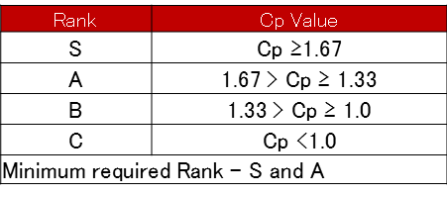
K0NA MODEL SPC – GPD
1/4
SUMMARY OF SPC STUDY- FOR PP1 & PP2 EVENT
Part name | S.R. No | Opt | Control Item | Specification | Cp PP-1 | Class | Cp PP-2 | Class | Remarks
GPD | 1 | Key way Broaching | Key way width | 4 +0.04 /+0.06 | 1.82 | S | 1.83 | S | OK
 | 2 |  | Key way Depth | 21.05~ 21.20 | 1.67 | S | 1.79 | S | OK
 | 3 | Hobbing | OBD | 38.793~ 38.773 | 1.47 | A | 1.43 | A | OK
 | 4 |  | PCD R/O | 0.032 | 1.53 | A | 1.62 | A | OK
 | 5 | Shaving | OBD | 38.623~ 38.588 | 1.51 | A | 1.54 | A | OK
 | 6 |  | PCD R/O | 0.025 | 1.64 | A | 1.47 | A | OK
 | 7 | Honing | ID | 19 +0.003 +0.013 | 1.41 | A | 1.58 | A | OK
 | 8 |  | PCD R/O | 0.032 | 1.40 | A | 1.41 | A | OK
GPD All Dimension OK & found in S & A Rank

Slide 2
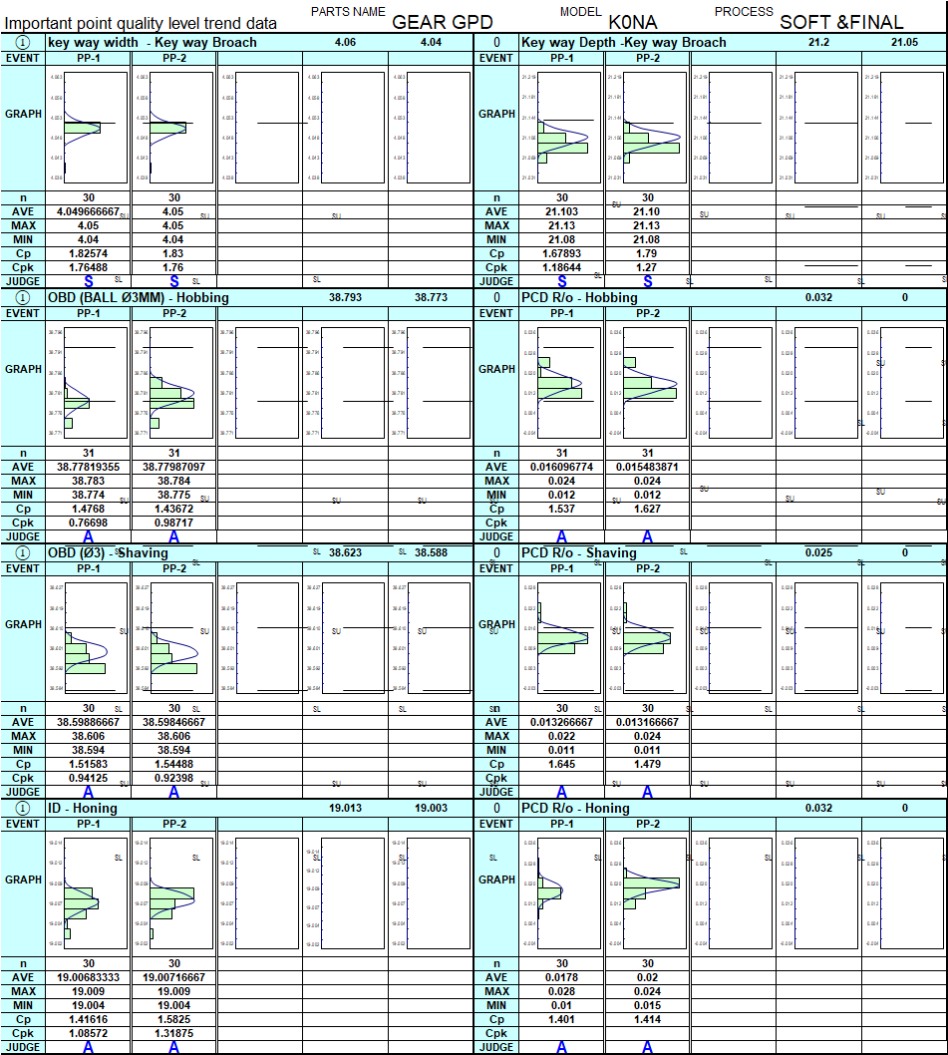
K0NA MODEL SPC – GPD
2/4
SUMMARY OF SPC STUDY- FOR PP-1 & PP2 EVENT

Slide 3
K0NA MODEL SPC – GPD
3/4
SUMMARY OF SPC STUDY- FOR PP1 & PP2 EVENT
Part name | S.R. No | Opt | Control Item | Specification | Left | Class | Remarks | Right | Class | Remarks
GPD | 9 | L & P | FA ( Pressure Angle) | 6 ~ 14 | 1.46 | A | OK | 1.84 | S | OK
 | 10 | L & P | TC ( Tooth Crowning) | 0~ 4 | 1.62 | A | OK | 1.67 | S | OK
 | 11 | L & P | ICW (Involute Curve waviness) | 0~ 4 | 1.45 | A | OK | 1.50 | A | OK
 | 12 | L & P | FFT (Tip Relief) | 5~ 15 | 1.41 | A | OK | 1.55 | A | OK
 | 13 | L & P | FH (Lead Angle) | 5~ -5 | 1.87 | S | OK | 1.82 | S | OK
 | 14 | L & P | CRN(Corning) | 0~ 6 | 1.58 | A | OK | 1.67 | S | OK
 | 15 | L & P | LCW (Lead Curve Waviness) | 0~ 4 | 1.43 | A | OK | 1.61 | A | OK
GPD All Dimension OK & found in S & A Rank

Slide 4
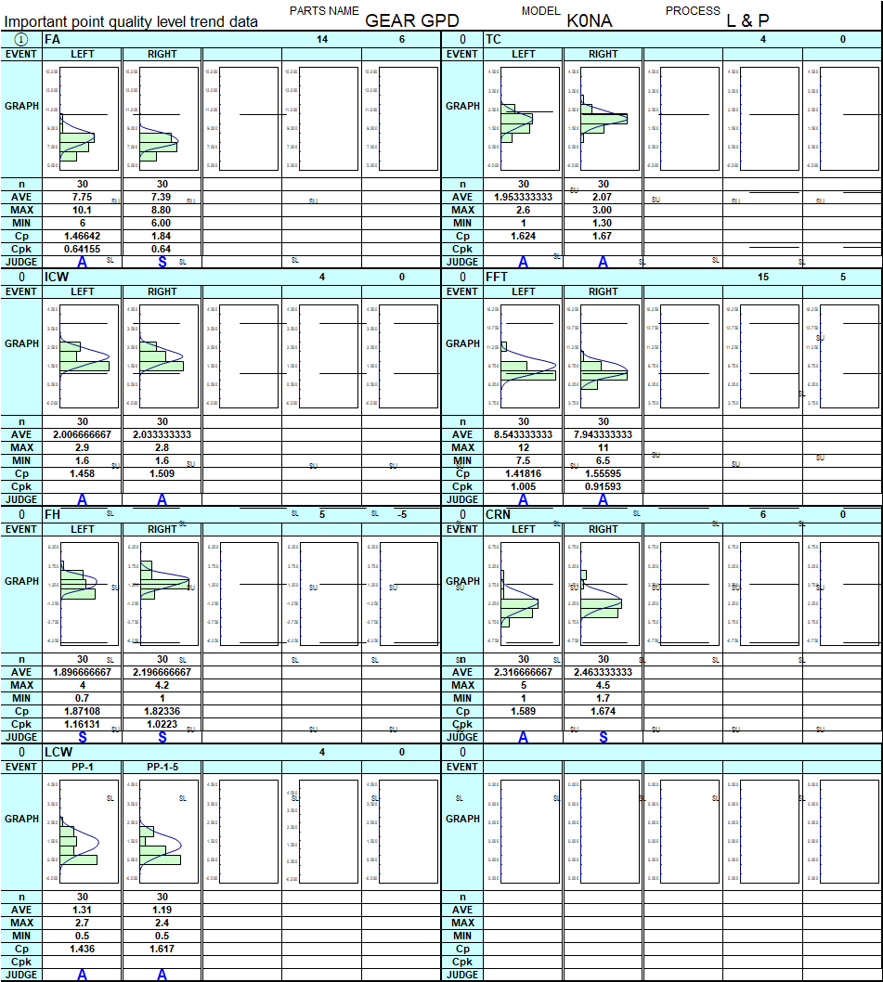
K0NA MODEL SPC – GPD
4/4
SUMMARY OF SPC STUDY- FOR PP-1 & PP2 EVENT

